Slide 1

Python Fundamentals (week 5)
Louis Rey
UCSD Extension

Slide 2
Week 5 Objectives
Introduction to Python for scientific programming
Numpy
Matplotlib

Slide 3
Numpy

Slide 4
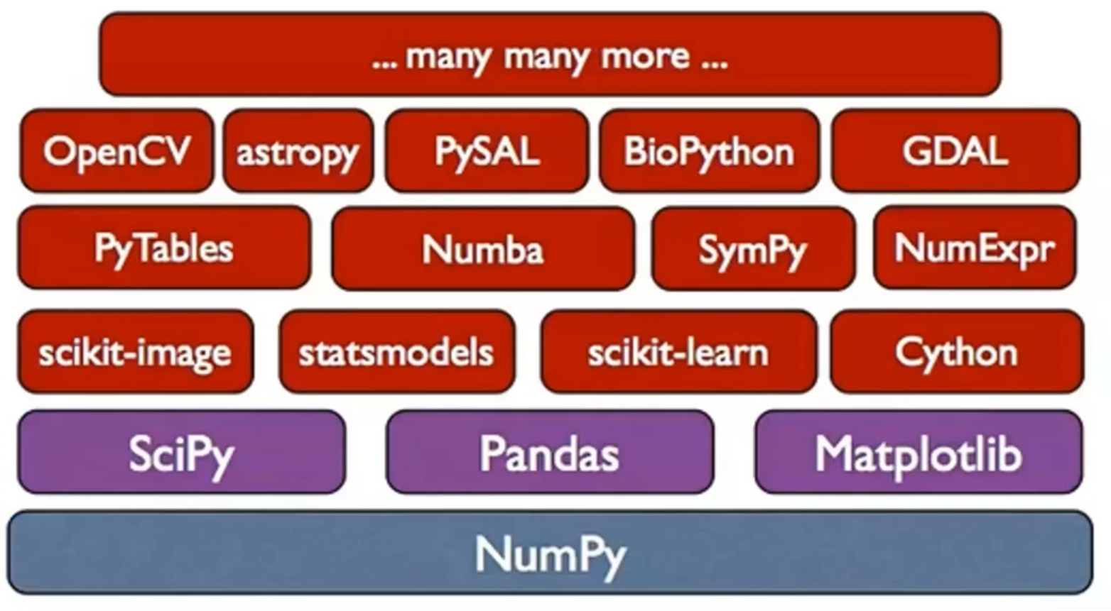
Numpy

Slide 5
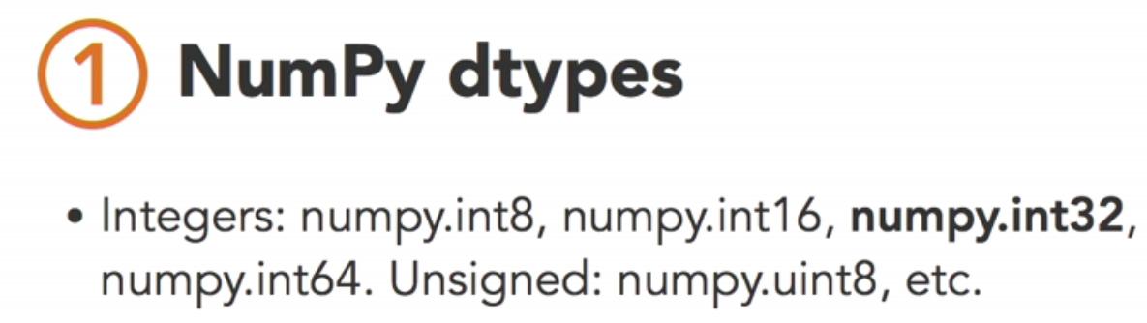
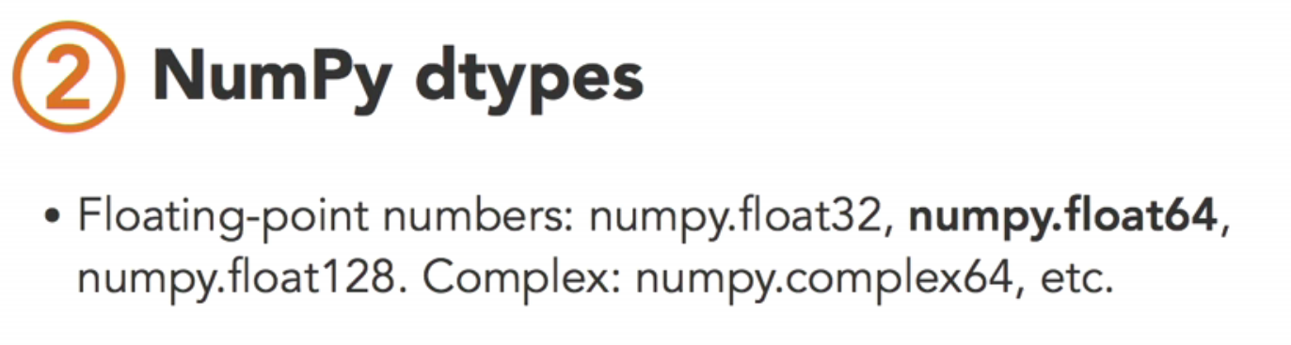
Numpy Datatypes

Slide 6
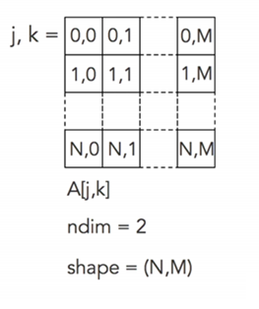
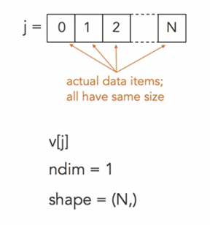



Numpy
Multidimensional array library

Slide 7
Numpy Arrays vs Lists
Memory efficient
Lower memory usage
Matrix operations easily implemented
Numerical operation specific
Range implemented as np.arange(n) where n is the length of the array

Slide 8
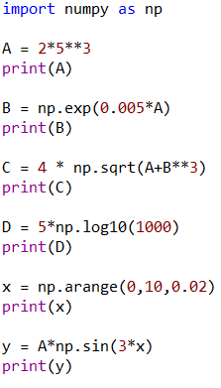
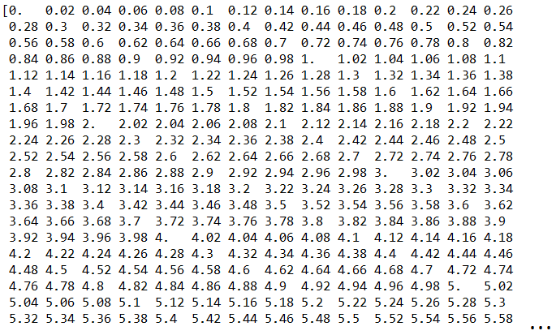
Numpy Operations

Slide 9

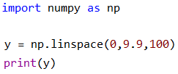
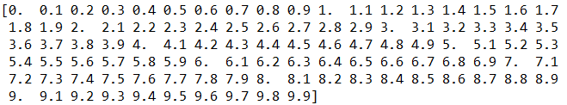
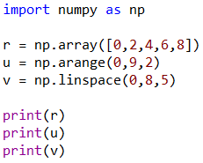



Numpy Array Range Operators

Slide 10




Numpy Row and Column vectors

Slide 11
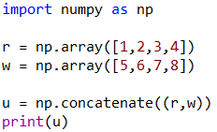
Numpy Arrays Concatenation

Slide 12
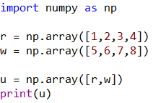

Numpy Matrix by Appending Arrays

Slide 13
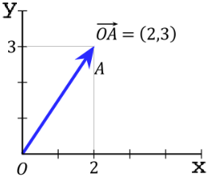
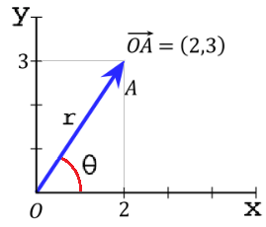
What is a Vector
A Euclidean vector is a geometric object that has magnitude (length) and direction
It can be characterized by (x, y) coordinates on a Cartesian 2D plane (they can also be m-dimensional)
A vector can also be characterized by its magnitude (length), given as r in the figure, and angle with respect to the x (horizontal) plane
Vectors have their own arithmetic operations

Slide 14
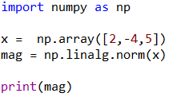


Numpy Vector/ Array Examples
Magnitude of a Vector

Slide 15
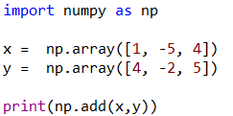
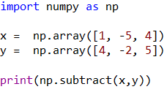
Numpy Vector Addition and Subtraction
Adding two vectors
Subtracting two vectors

Slide 16
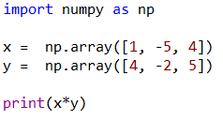
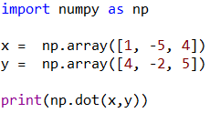
Numpy Vector Multiplication
To multiply points within a vector, do a point by point multiply
To multiply two vectors with the same length together, take the Sum Product, also called dot or inner product

Slide 17
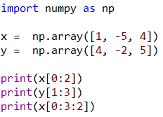

Numpy Vector/ Array Indexing

Slide 18
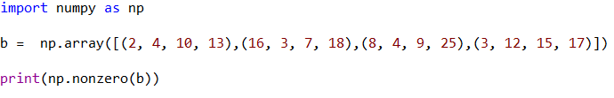
Numpy Matrix Non-Zero Indexing
Finds all the indices of the non-zero elements by returning row and column index vectors

Slide 19
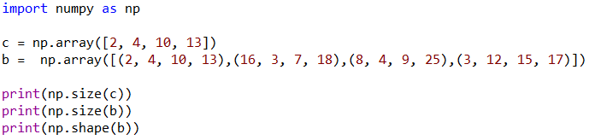

Numpy Size of Vectors and Matrices

Slide 20
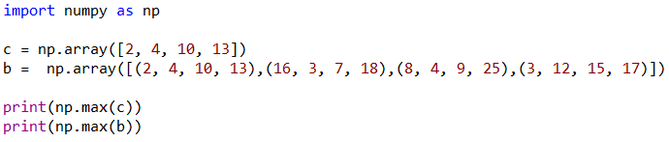
Numpy Maximum Values of Vectors and Matrices

Slide 21


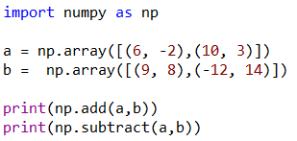


Numpy Matrix Addition and Subtraction

Slide 22

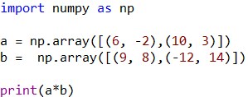


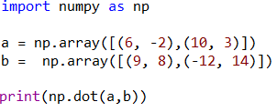

Numpy Matrix Multiplication
To multiply points within a matrix, do a point by point multiply
To multiply two Matrices of sizes (n x m) and (i x j), the resultant matrix is of size (n x j). We do this by taking the Sum Product, also called dot or inner product

Slide 23
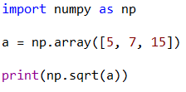
Numpy Operations using Vectors
Square root of elements in a vector:
To evaluate sin(x ² + 5), you can type np.sin(x**2 + 5)
To evaluate sin(√x+1), you type np.sin(np.sqrt(x)+1)
In both cases above, x can be a constant or a vector value

Slide 24
MATPLOTLIB

Slide 25
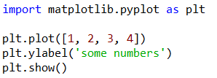
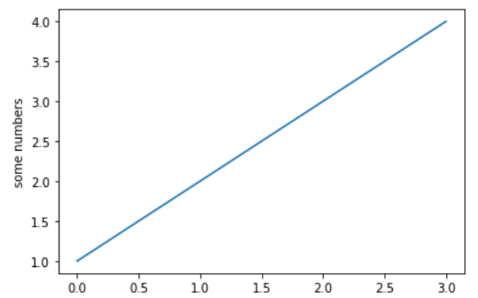
Matplotlib Pyplot
matplotlib.pyplot is a collection of functions to plot figures using data created by the user

Slide 26
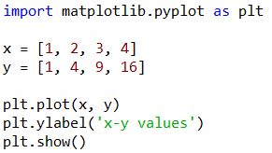
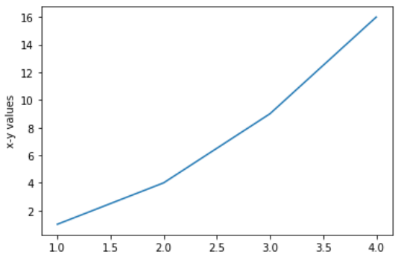
Matplotlib Pyplot
Setting x and y vlaues

Slide 27
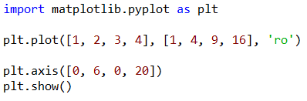
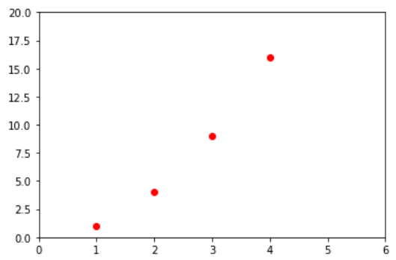
Matplotlib Pyplot
Formatting plot using line type and color

Slide 28
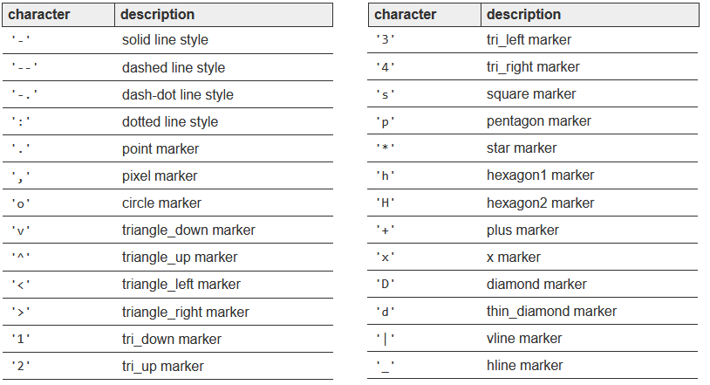
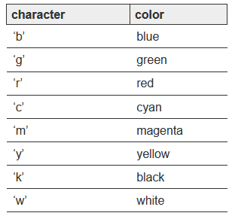
Matplotlib Pyplot Markers and Colors
Markers
Colors

Slide 29
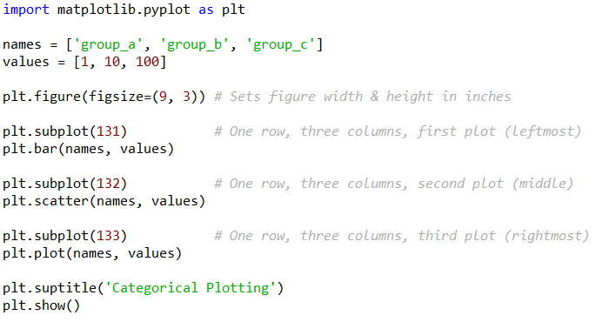
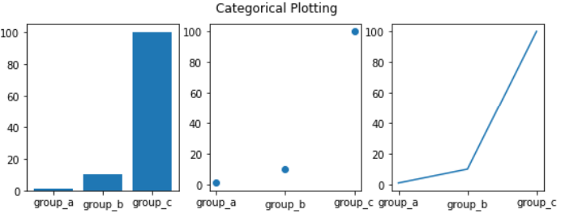
Matplotlib Pyplot Scatterplot
Plotting multiple figures using subplot method

Slide 30
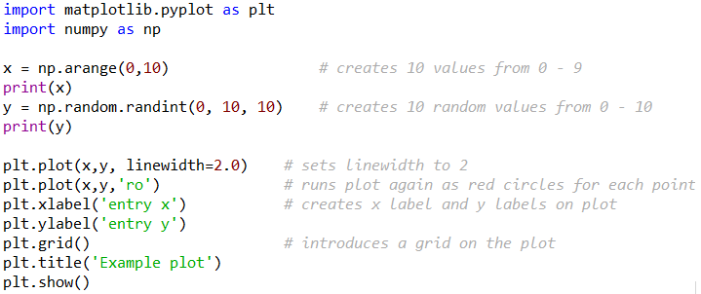
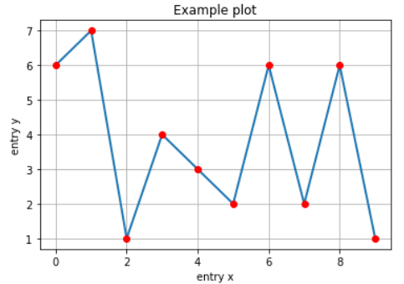
Matplotlib Pyplot Properties
Can change line width using the keyword linewidth
grid allows you to place a grid on the plot
Can place labels on the x and y axes

Slide 31
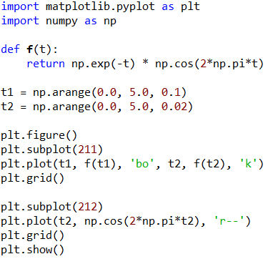
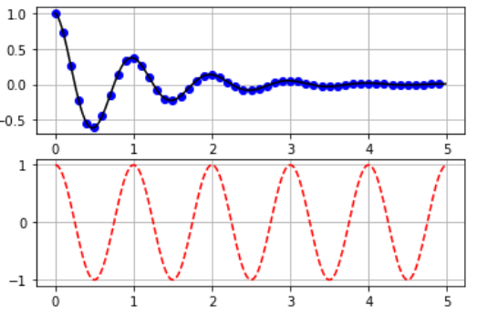
Matplotlib Pyplot using Functions

Slide 32
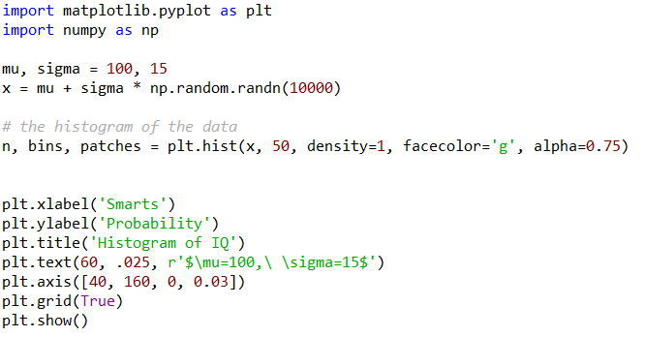
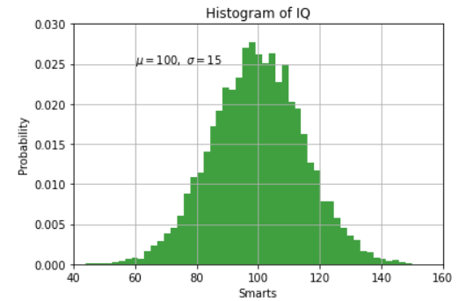
Matplotlib Pyplot using Functions
density returns a probability density function
alpha specifies the transparency of the histogram

Slide 33
Resources
Matt Huenerfauth (Penn State)
Guido van Rossum (Google)
Richard P. Muller (Caltech)
Bill Boyd (Weslayan University)
Smithsonian Telescope Data Center
Programming Python, Mark Lutz
Fundamentals of Python, Kenneth Lambert

